Slide 1

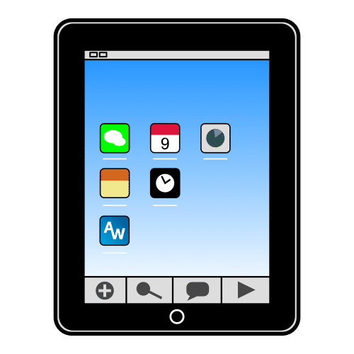
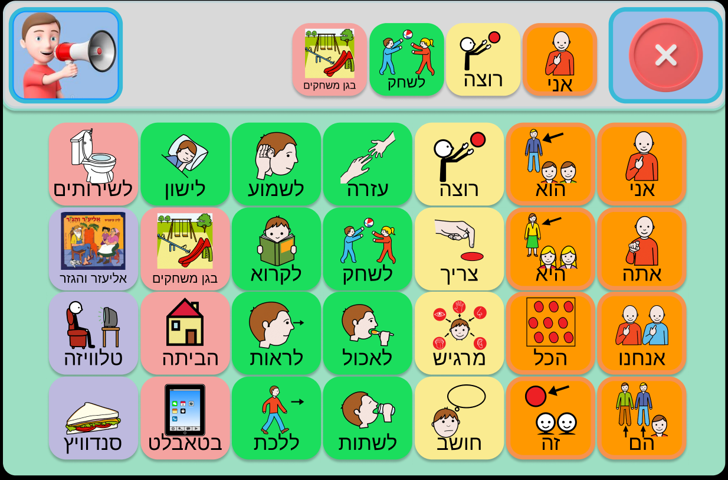
Diburnik
Communication Board Application Intended For Children
With Complex Communication Needs
Capstone Project Phase 1
23-2-D-6
Presented by:
Nadav Cohen
Sharon Snitivker
Supervisor:
PhD Julia Sheidin

Slide 2
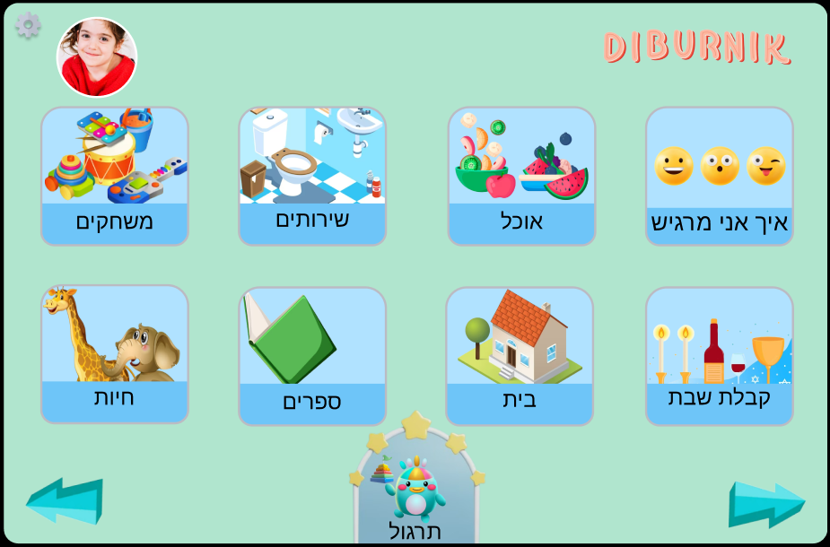
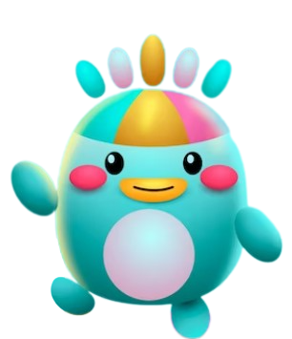
01
INTRODUCTION
Notes:
שרון

Slide 3
What are Complex Communication Needs (CCN) ?
Complex Communication Needs (CCN) are resulting from a wide range of developmental disabilities such as: autism spectrum disorders, cerebral palsy, down syndrome, and other special needs.
Children With CCN
Often do not develop speech and language skills as expected.
Their speech abilities may be limited
They might experience delayed speech development or have speech that is difficult to understand
These communication challenges can result in them being:
Severely restricted in their ability to communicate effectively with others
Making their needs and wants unknown
Notes:
שרון

Slide 4
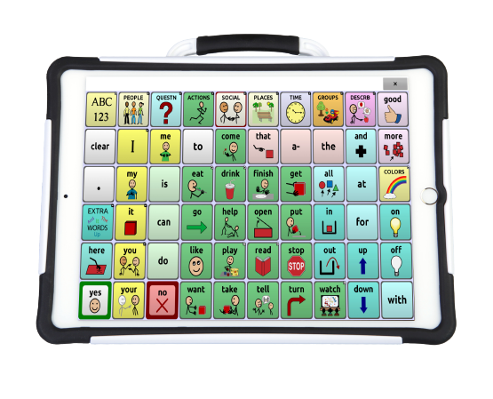
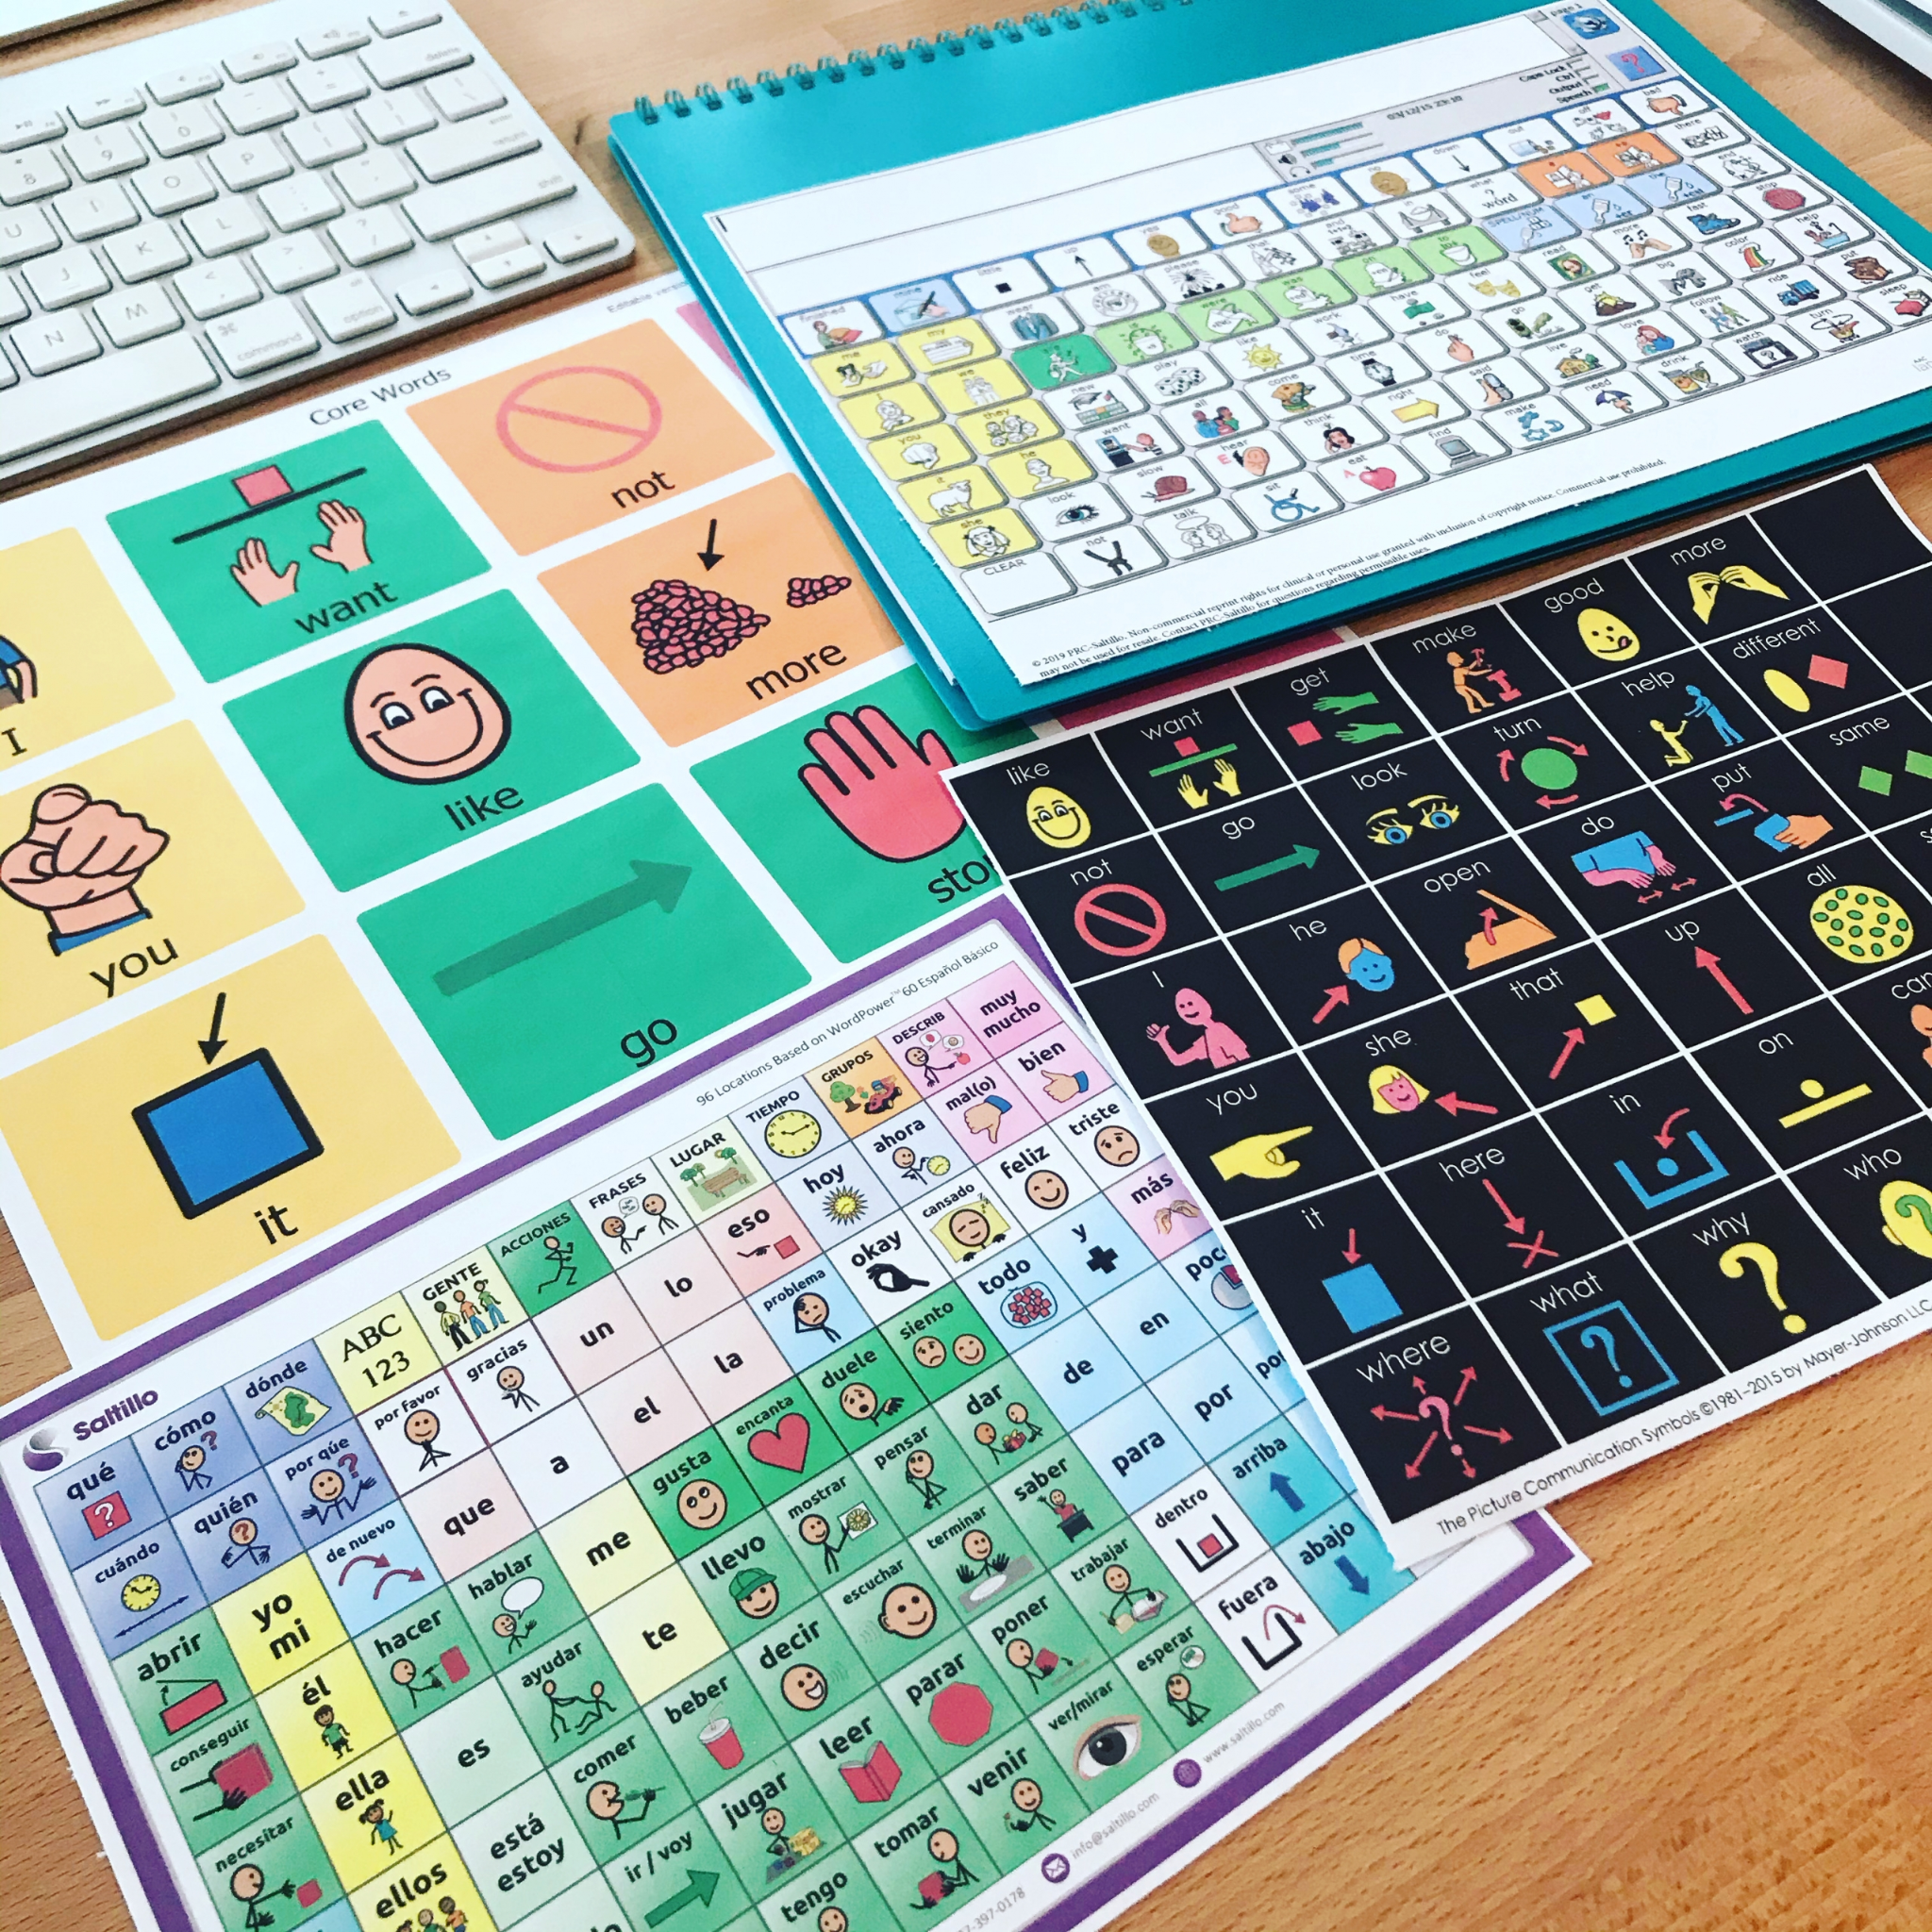
What is a Communication Board ?
Communication Boards are a distinct category within the broader field of Augmentative and Alternative Communication (AAC) tools. They are visual displays utilizing symbols, pictures, or words to aid individuals with speech challenges in expressing themselves, facilitating effective interaction through both low-tech and high-tech variants.
Image Source
Image Source
Notes:
שרון

Slide 5

Our Collaboration
We will collaborate with “Eshkol Geni Yuvalim”, a kindergarten campus , located in Upper Afula.
The campus is a home for children between the ages of 3 and 7 who have complex disabilities such as: cerebral palsy and /or developmental delays of varying levels.
Notes:
שרון

Slide 6
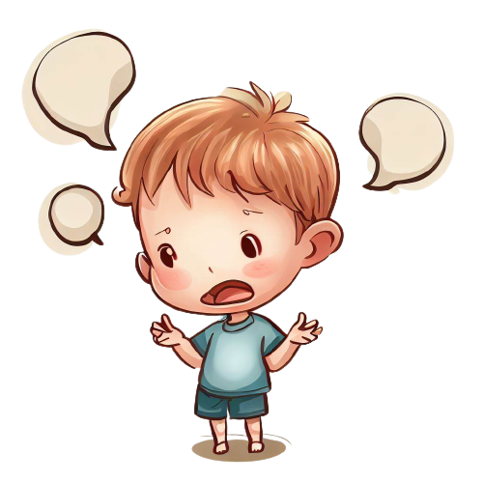
The Problem
Children with CCN face challenges in expressing themselves due to conditions like learning disabilities, autism spectrum disorder, brain injuries and more.
These conditions hinder their ability to communicate effectively through conventional means.
Current solutions are expensive.
Some solutions lack support for Hebrew language or exclusively cater to either Android or iOS devices.
Current solutions require the children to use their personal tablet device to access their custom boards.
Notes:
שרון

Slide 7


02
Related Work

Slide 8



Available Existing Computerized Solutions
The existing solution
Customizable: Personalized communication solution
Early communication: Ideal for initial communication stages.
Hebrew support: Supports the Hebrew language.
Multiple communication modes: Text-to-speech, symbol-based, and image-based options.
iOS only: Not available for Android devices.
Child-friendly design needed: Enhance children's independence.
Paid app: Cost is 899.90 NIS, one-time purchase.
No user profiles: Can't access customized boards on different devices.
Busy interface: Difficult to use, time-consuming.
No training feature: Lacks training component.
Notes:
נדב

Slide 9
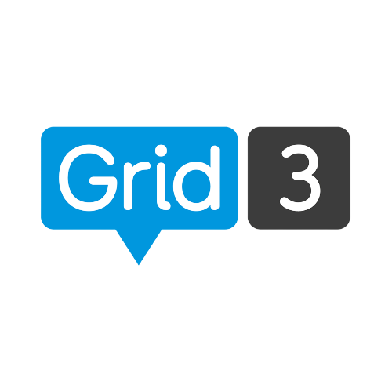
Available Existing Computerized Solutions
Another solution
Paid subscription: Monthly £10 or one-time £400 payment
Manual board transfer: Boards downloaded on computer, manually transferred to tablet.
Limited custom board creation: No option to create custom boards, only predefined ones available for download.
Navigation complexity: Multiple menus to access communication board, not readily available.
No user profiles: Unable to create profiles for different users on the same device.
Hebrew language support: Enables communication in Hebrew.
Free board downloads: Allows users to freely download boards without any cost.
Quiz feature: Engage in interactive quiz activities.
Cloud backup option: Ability to back up boards on the cloud.
Notes:
נדב

Slide 10
Semantic Augmentative Communication Boards
ACBs are utilized as a compensatory technique for individuals with CCN.
Offer visual cues and assistance in the formation of telegraphic phrases.
These boards include different components, such as colors and cards, which represent the grammatical class and meaning of words.
The Semantic ACB combines three essential materials:
Colorful Semantics (CS)
Language Acquisition Through Motor Planning (LAMP)
Semantic Grammar (SG):
Notes:
נדב

Slide 11
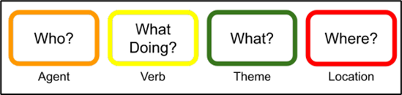
Colorful Semantics (CS)
The main advantage of CS is the identification of semantic roles, including the agent, verb, theme, and location.
This method provides support to children with a limited vocabulary in organizing the grammatical content of their sentences.
Utilizes a system of colors associated with questions to represent the semantic roles of sentence elements.
Colors are used to visually distinguish between each role, and alert the child when a role is omitted.
Notes:
נדב

Slide 12
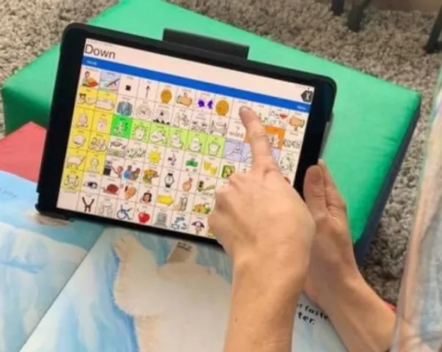
Language Acquisition Through Motor Planning (LAMP)
focuses on motor planning and memory to support language development
pictures that are set in consistent and unique positions
practice the repetition of physical movements when locating specific words
Notes:
נדב

Slide 13
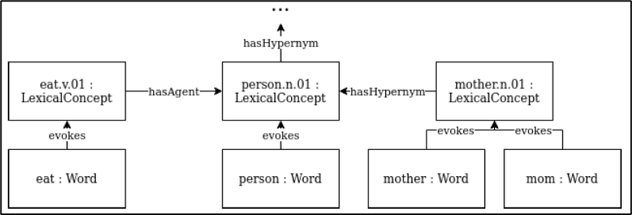
Semantic Grammar (SG)
Semantic Grammar is a structured framework used for constructing sentences on a communication board.
It guides the process of creating messages and ensures the sentences formed are both semantically accurate and meaningful.
Notes:
נדב

Slide 14

03
Expected Achievements
Notes:
שרון

Slide 15
Expected Achievements
1. Effective communication and independence:
The child's ability to effectively communicate with his surroundings independently will be improved by using our application.
2. Long-term impact:
The project should have a lasting impact on the child's development, providing benefits that extend beyond the duration of their engagement with the application.
3. User satisfaction:
Feedback from both the child and the adult users should indicate a high level of satisfaction with the application, including its usability, features, and overall experience.
Notes:
נדב

Slide 16

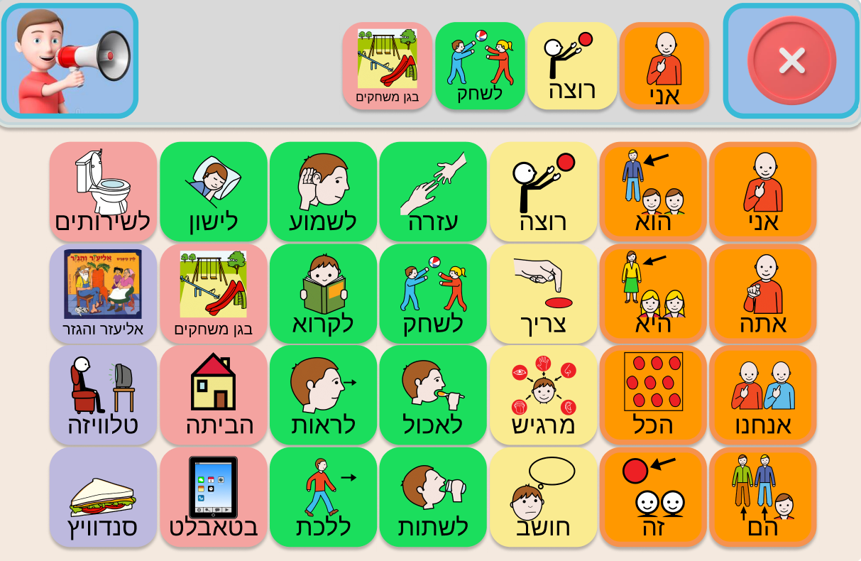
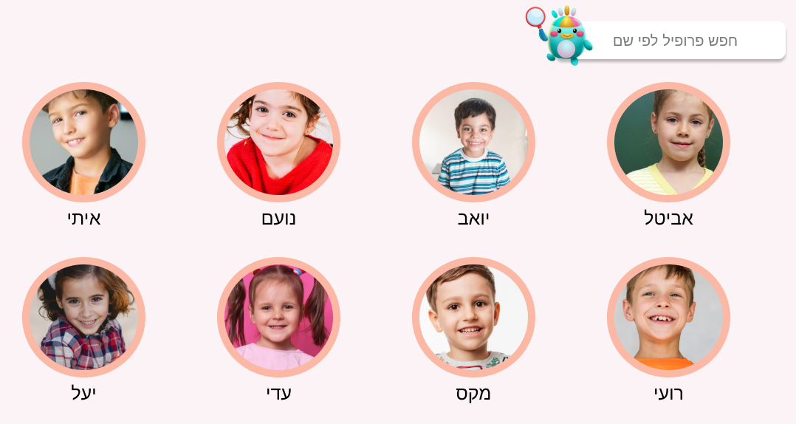
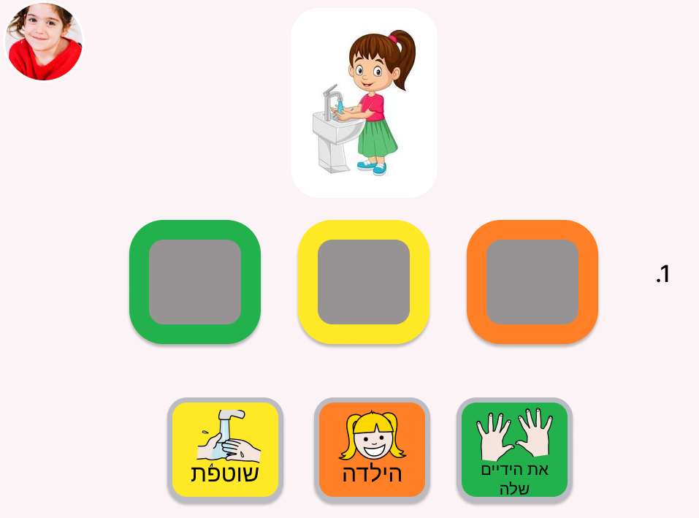
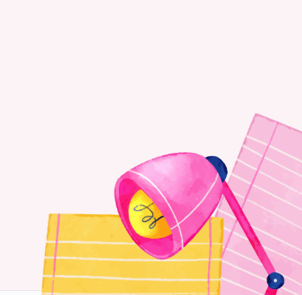
Main Features
Users Profiles
Communication Board
Training Area
Accessibility to the customized communication board from any device the application is installed on
Allowing multiple users to be logged-in to the same device simultaneously
Allowing the child to practice and to strength his speaking and language skills
Allowing the speaking therapist to keep track on the child's progress
The GUI is designed to be child-user-friendly
Notes:
שרון

Slide 17
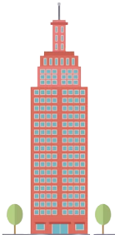
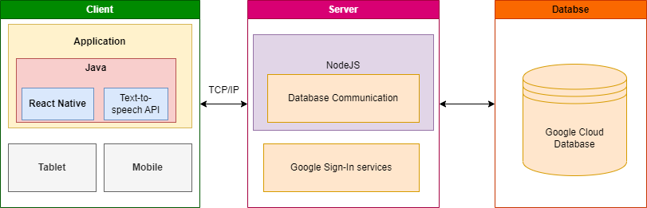

Project Architecture
Supporting:
Notes:
נדב

Slide 18
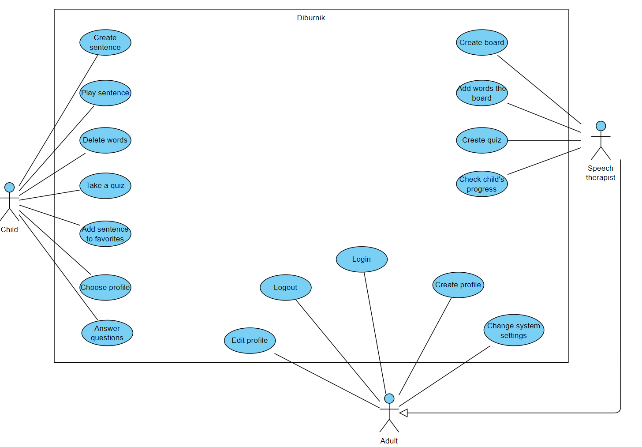
Use Case
Notes:
נדב

Slide 19
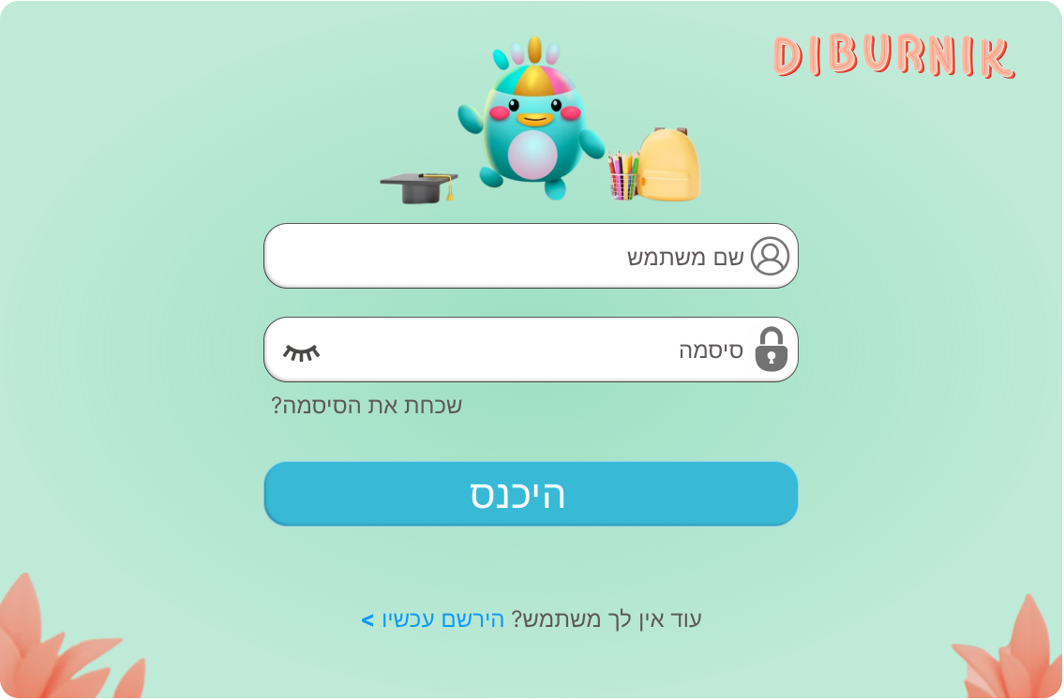
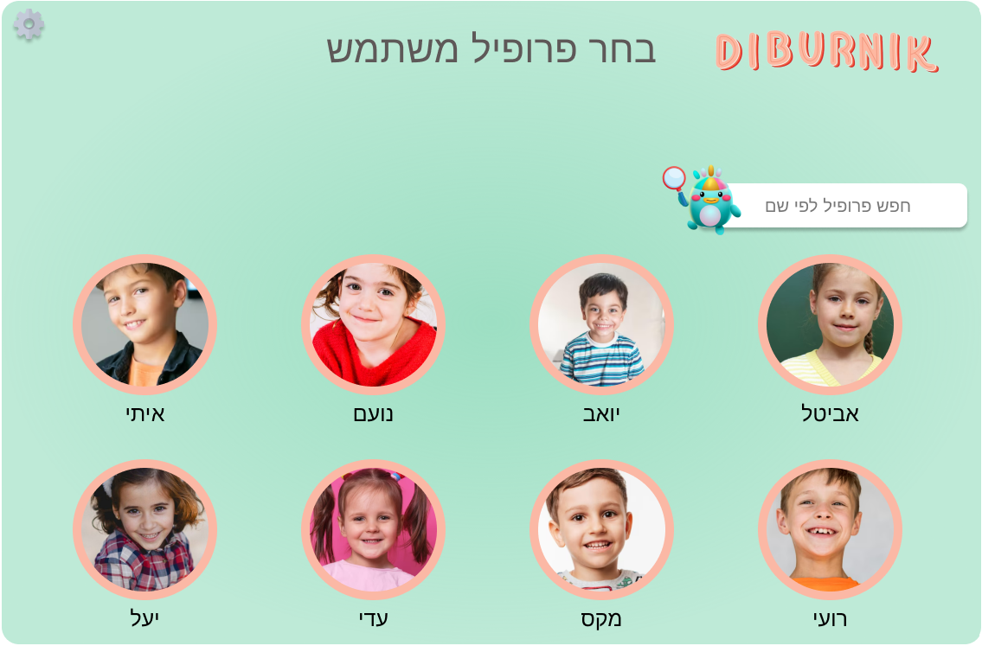
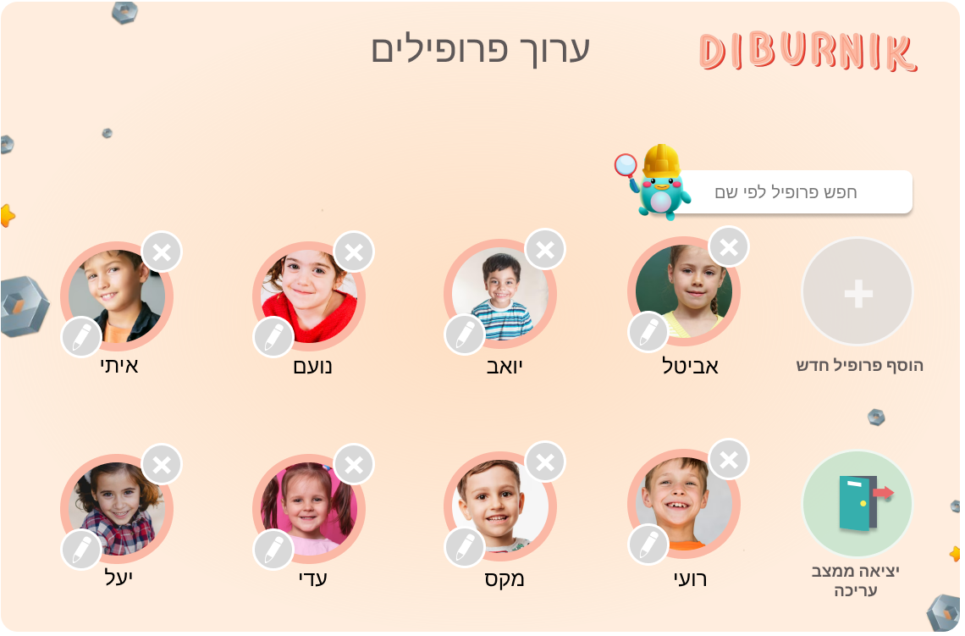
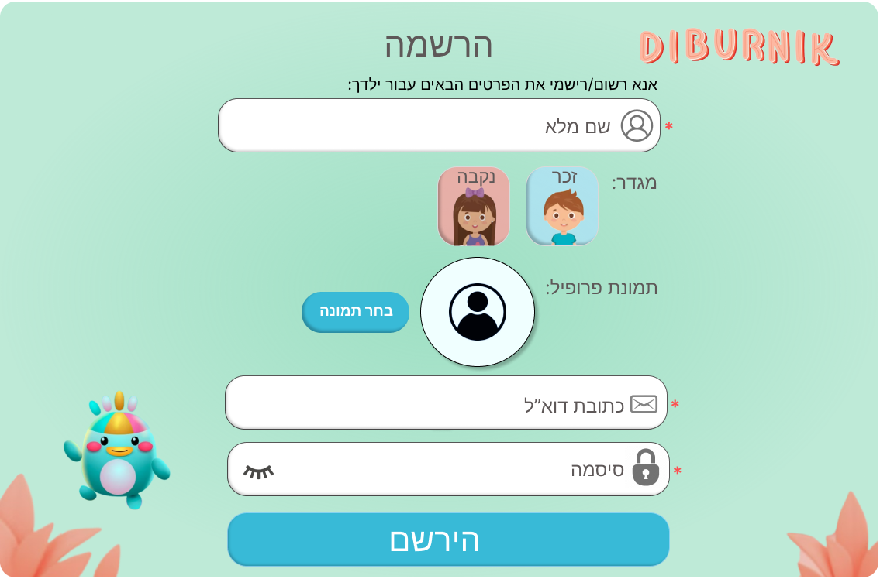
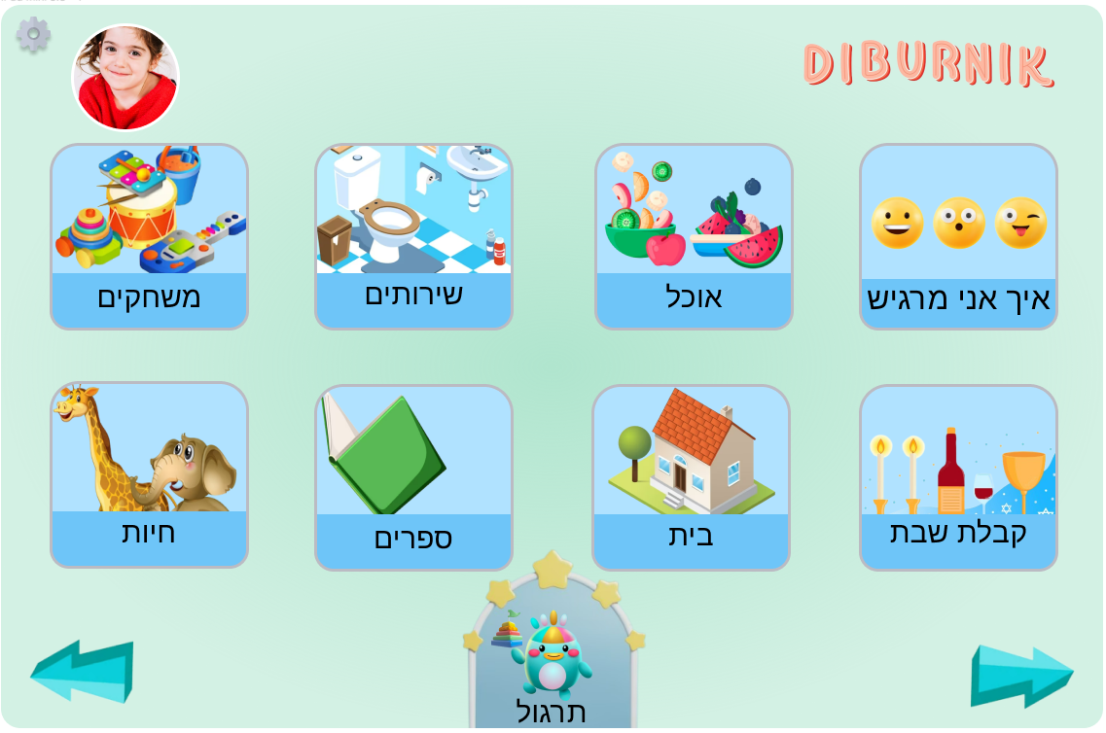
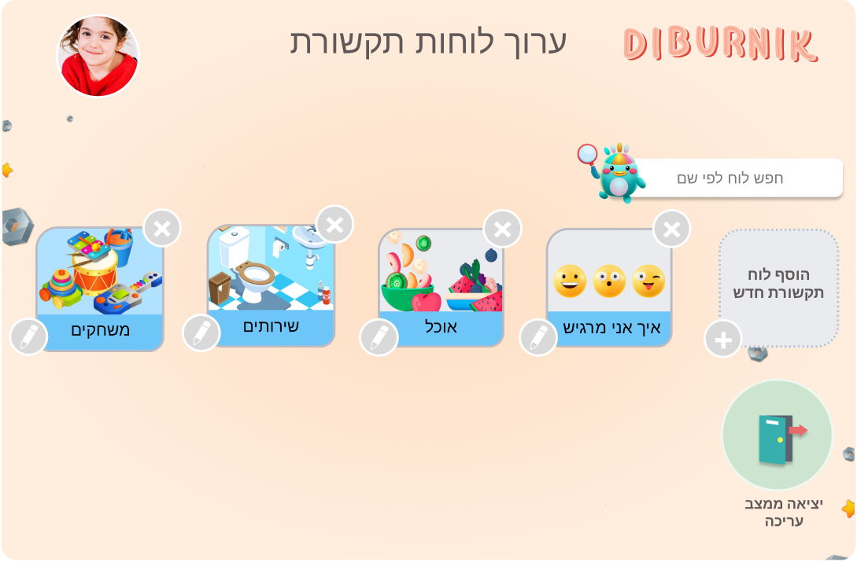
GUI Prototype
Notes:
נדב

Slide 20
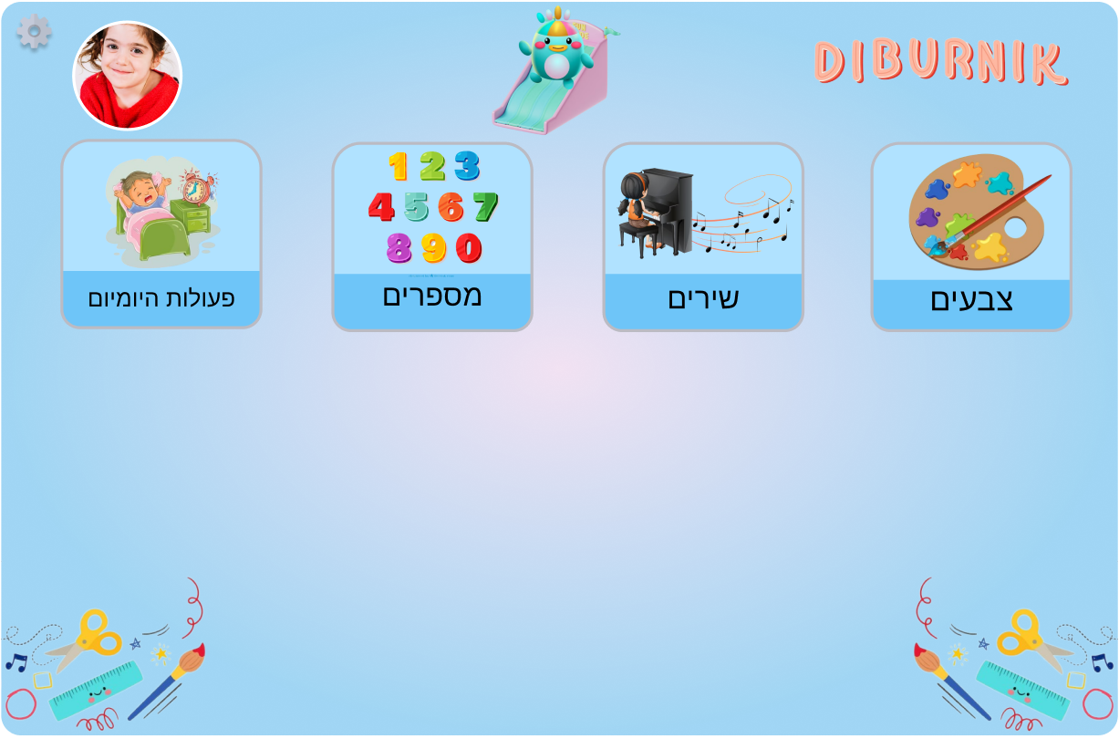
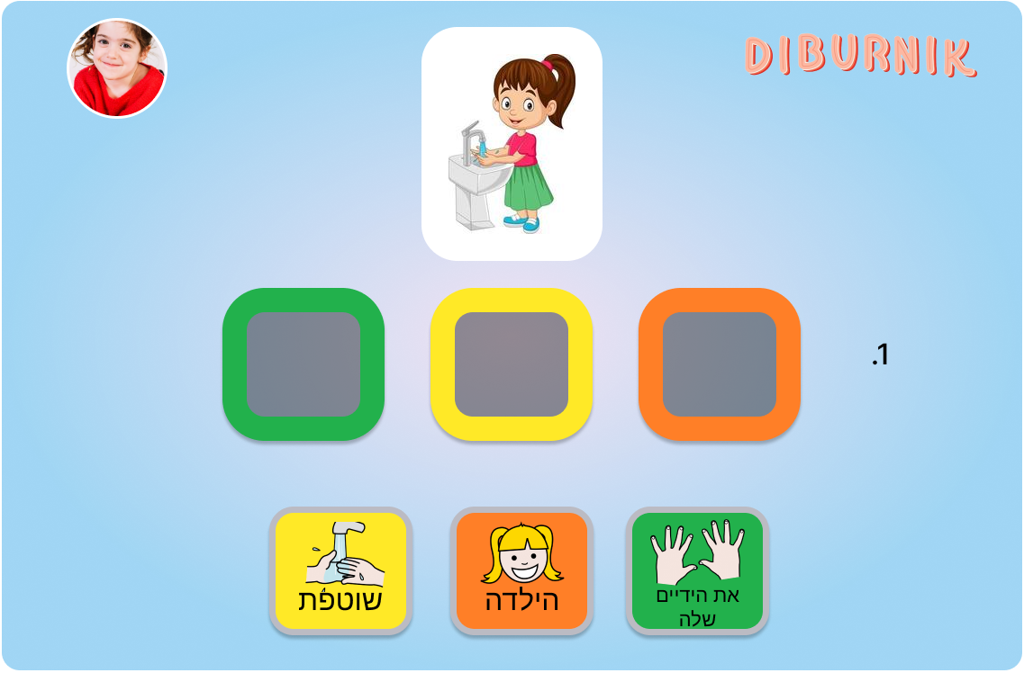
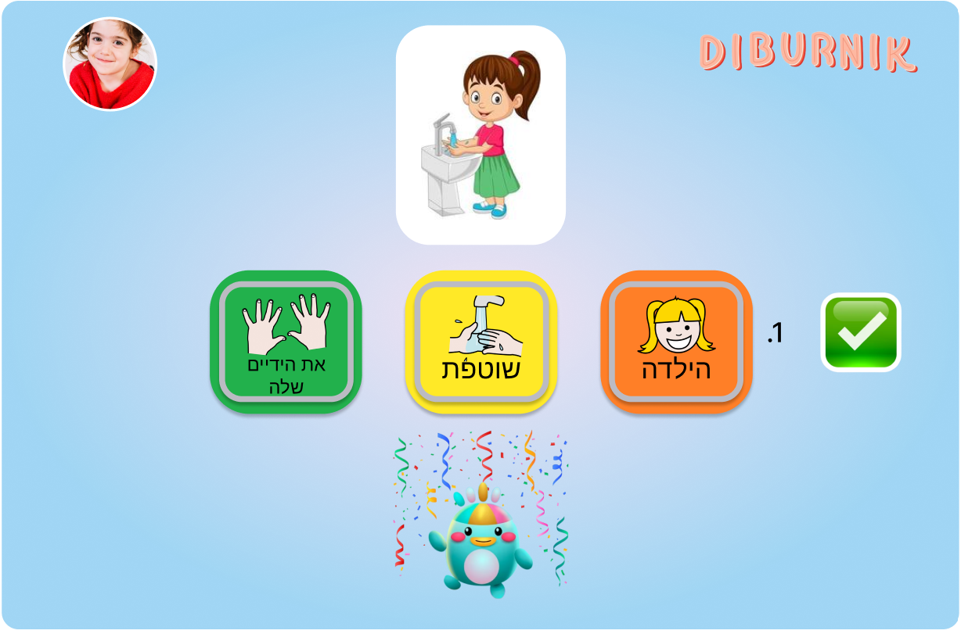
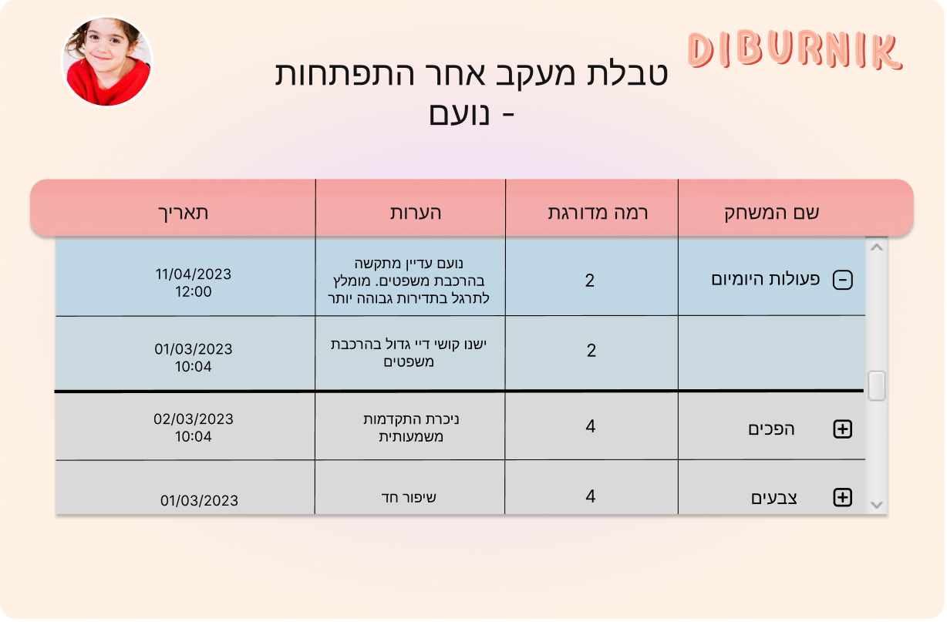
GUI Prototype
Notes:
נדב

Slide 21
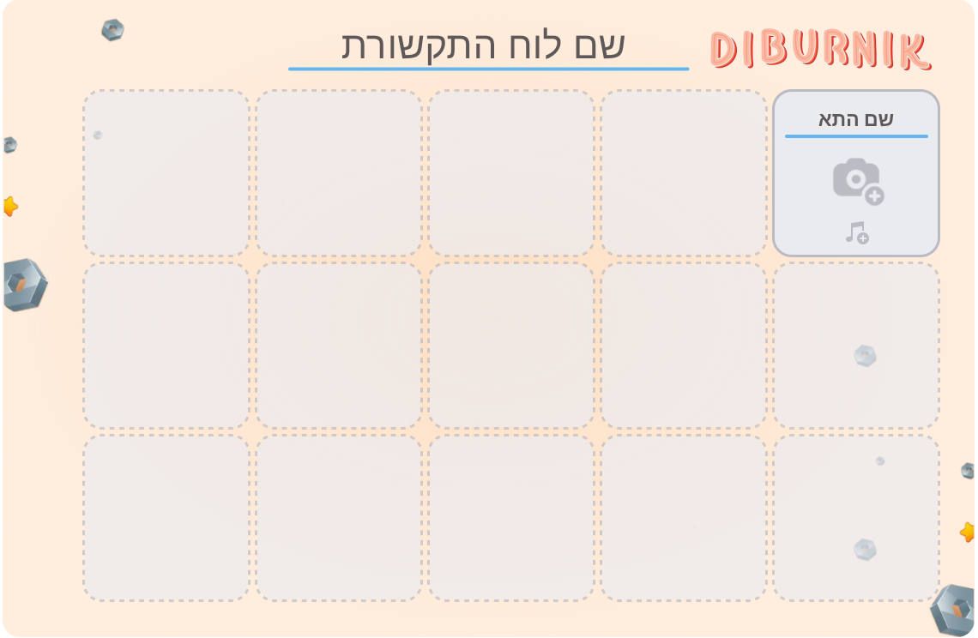
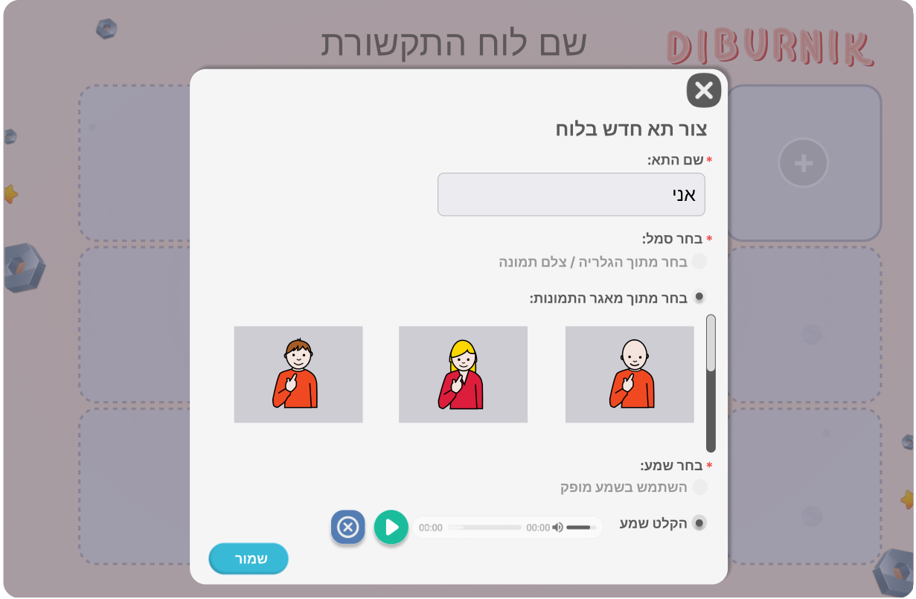
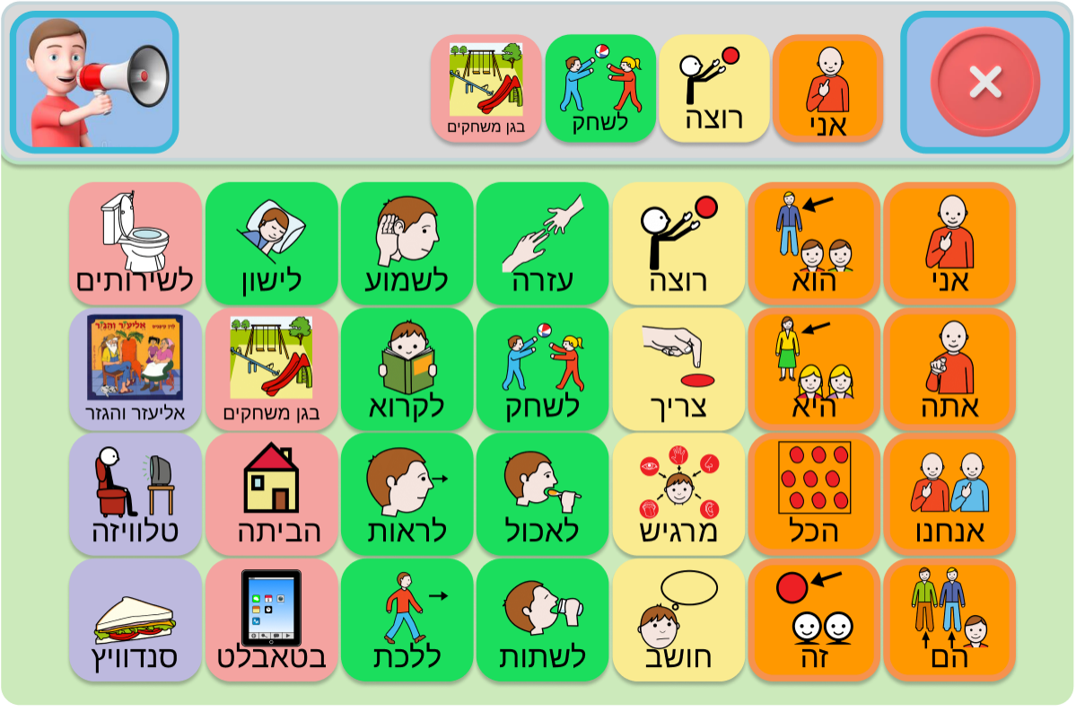
GUI Prototype
Notes:
נדב

Slide 22
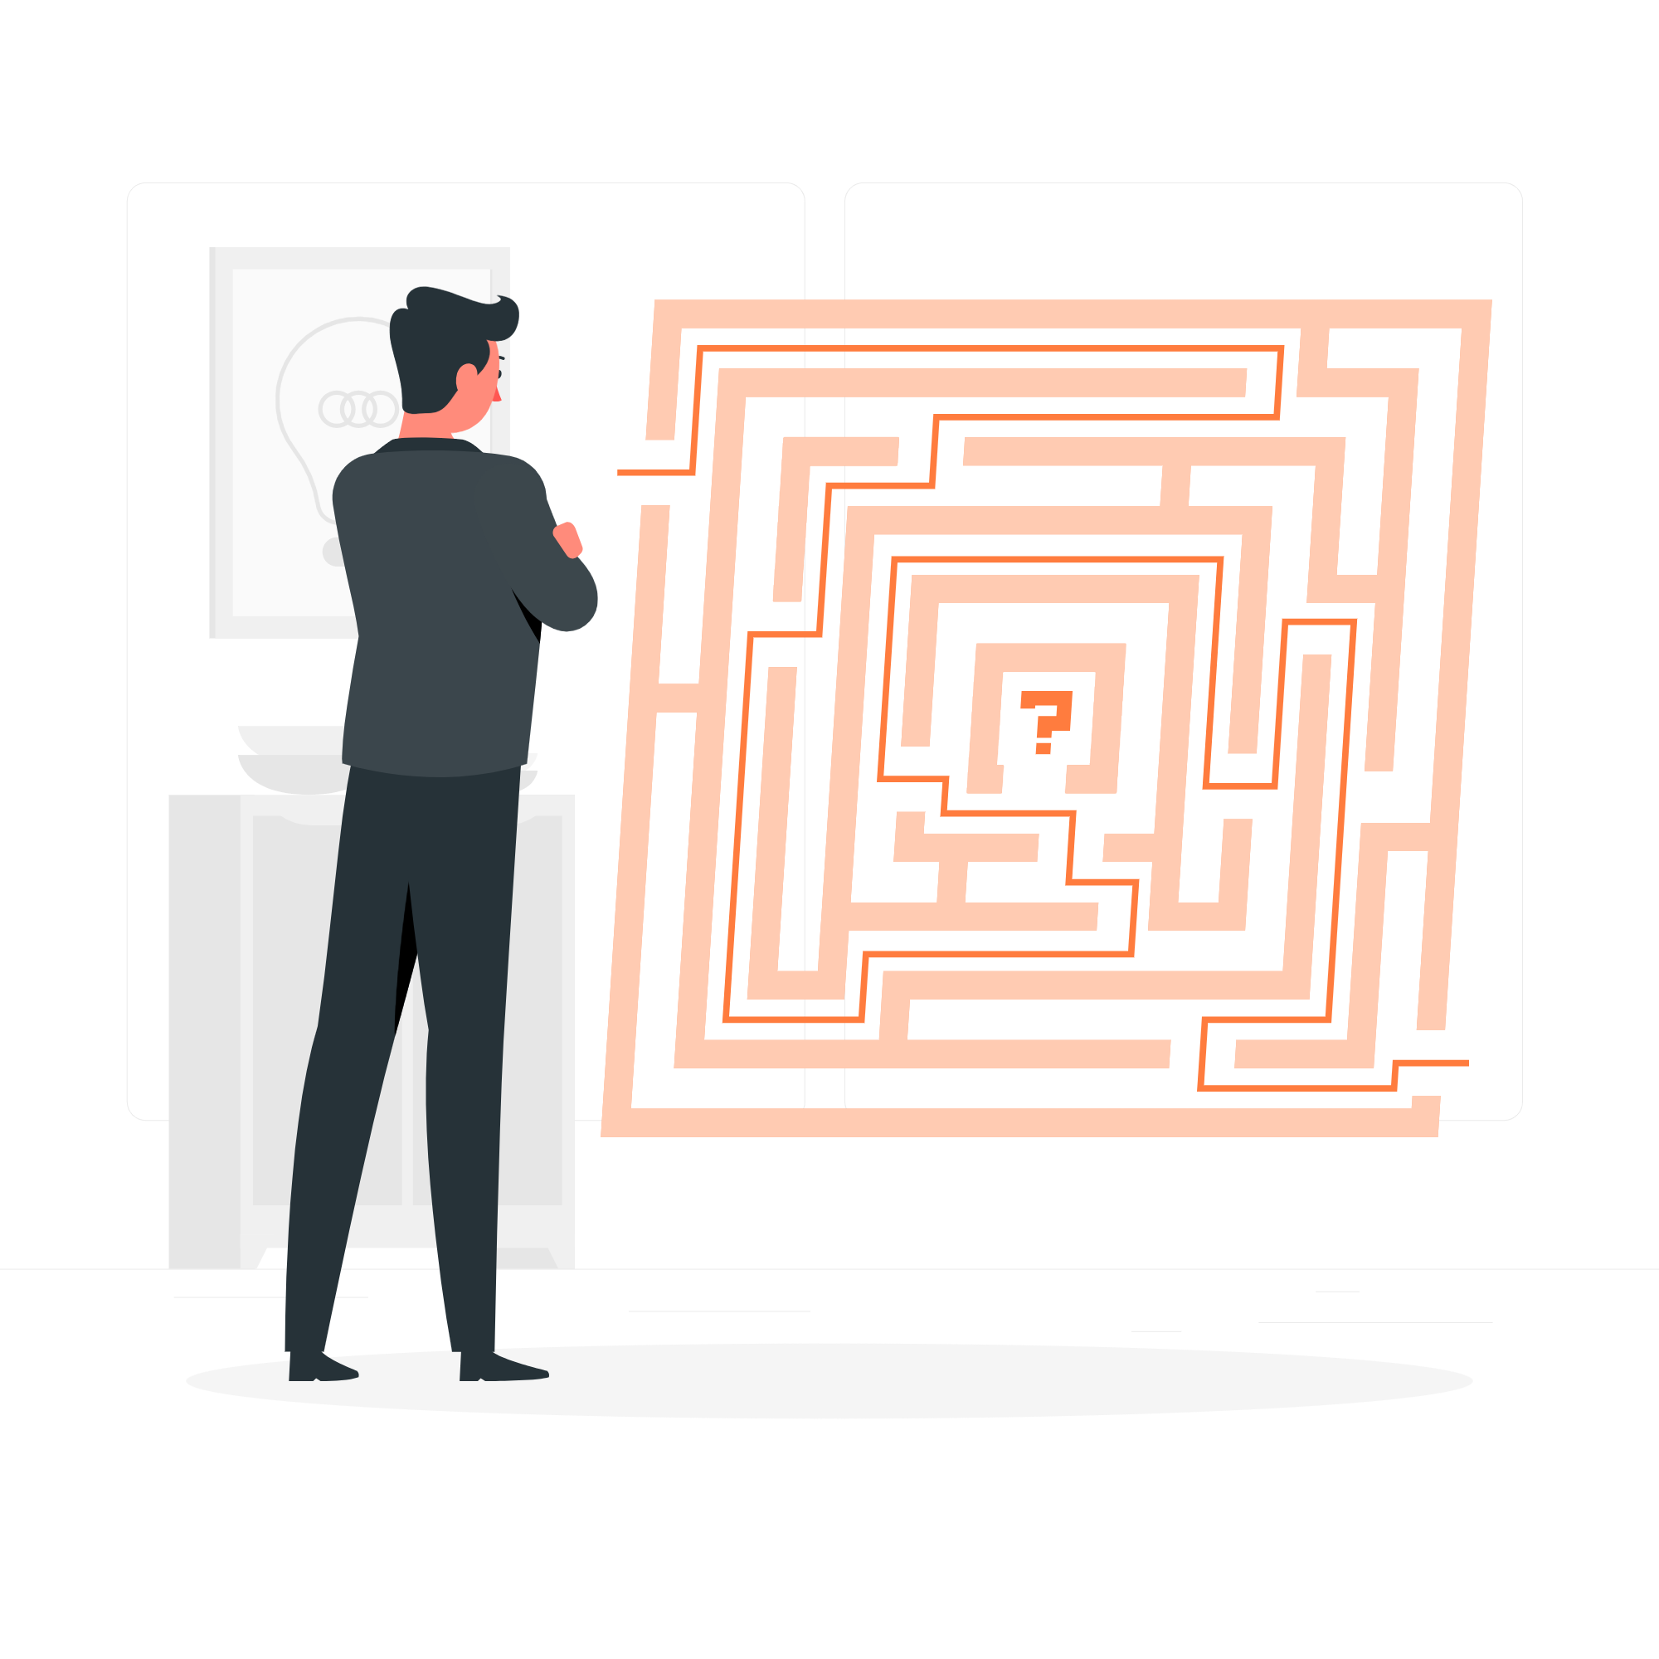
04
Challenges
Notes:
שרון

Slide 23
Challenges
1. Cross-Platform Compatibility: Ensuring that our application works well on all devices adds an extra layer of complexity. We'll need to consider various screen sizes, resolutions, and device-specific features, which may require additional testing and optimization.
2. Text-to-speech API: We'll have to understand and work correctly with the API.
Notes:
נדב

Slide 24
05
Verification Plan
Notes:
שרון

Slide 25
Hence, is an example of a test cases:
Test Subject | Test Headline | Expected Result
Create sentence | The child builds the sentence he wants to say | The application builds the sentence and displays it at the top of the screen
Play sentence | The child clicks on the speaking button | The application plays the sentence aloud
Take a quiz | A child press on “take on quiz” and answer the questions | The app gives feedback to the child
Notes:
שרון

Slide 26
Thank you for listening!
The End
Does anyone have any questions?

